Slide 1
EU helps to strengthen the capacity of EAM
Brief presentation of the EU funded TW project
Slavomír Šťastný
Resident Twinning Advisor

Slide 2
General Project Overview
Funded by the European Union
EU funded budget: EUR 823,529.41
Implementation Period
21 months from 1 April 2023 to 1 January 2025
Beneficiary Administrations
Employment Agency of Montenegro (Main Beneficiary)
Ministry of Labour and Social Welfare

Slide 3
General Project Overview
Consortium of Member States Partners
Lead Member State Partners
SLOVAKIA
Slovak National Twinning Platform: Regional Development Agency Pezinok-Senec
Ministry of Labour, Social Affiars and Family
of Slovak Republic

Slide 4
General Project Overview
Consortium of Member States Partners
Junior Member States Partners
GERMANY
Federal Ministry of Labour and Social Affairs
Federal Employment Agency
Federal Ministry of Economic Affairs and Climate Action

Slide 5
General Project Overview
Consortium of Member States Partners
Junior Member States Partners
ESTONIA
Ministry of Economic Affairs and Communications of Republic of Estonia

Slide 6
Project Components
1
Services adressing labour market needs with focus on ALMM and Youth Guarantee
Strengthening the EAM institutional capacity to participate in ESF
2
3
Support for improving labour force mobility and preparation to join EURES network

Slide 7
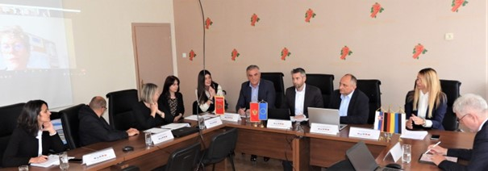
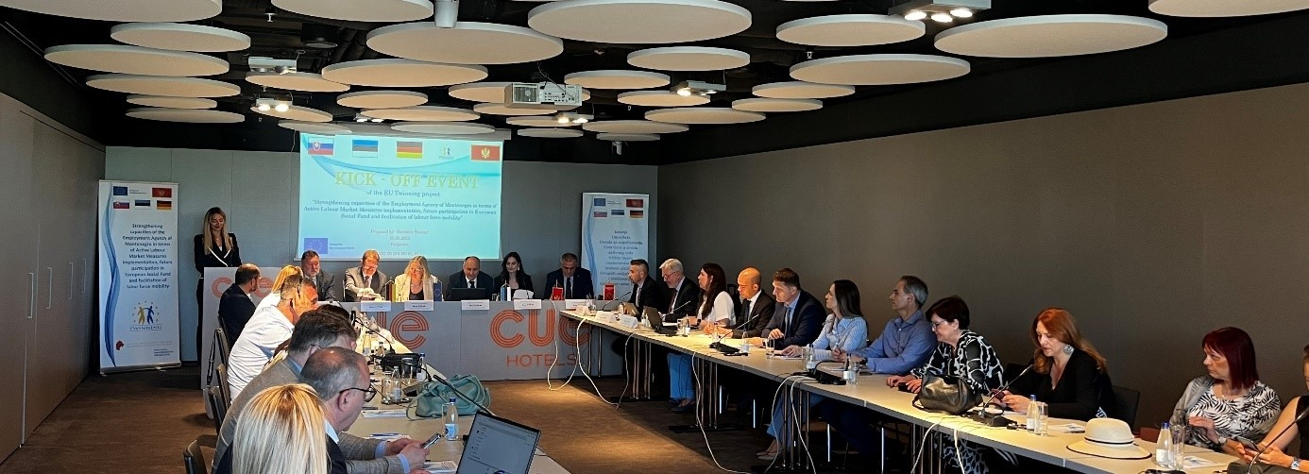
Start of Project
1 April 2023
Opening Steering Committee
9 May 2023
Kick-off Conference
9 June 2023

Slide 8
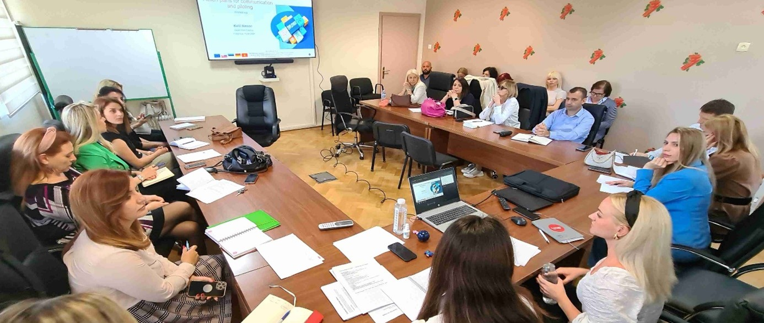
Until today within all 3 components
13 short-term experts
spent
303 Working Days
on project implementation

Slide 9
Project Outputs: Methodology and Handbooks
Activity 1.2 Methodology for design, implementation and monitoring of ALMMs
Activity 1.4 Roadmaps to provide Unemployed clients with a good quality offer
Activity 1.6 Capacity building, piloting and communication plan for Youth Guarantee implementation

Slide 10
Project Outputs: Methodology and Handbooks
Activity 2.4 Guidelines for institutional engagements in ESF projects in accordance with experience and best practice of EU Member state
Activity 3.1 Handbook covering topics that govern the free mobility of workers

Slide 11
Project Outputs: IT Support
Activity 1.3 IT module for management of ALMMs and Youth Guarantee offer
Activity 3.3 EURES IT solutions – Compliance of IT system with EURES standards / EURES interoperability

Slide 12
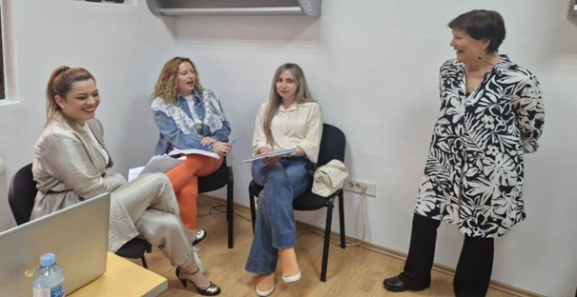
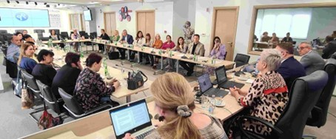
Project Outputs: Trainings
92 counsellors trained within Activity 1.5 on profiling, activation, individualised counselling, job matching, monitoring of ALMMs
More than 30 employees trained within Activity 2.3 on programming, implementation and monitoring of employment interventions from EU funds

Slide 13
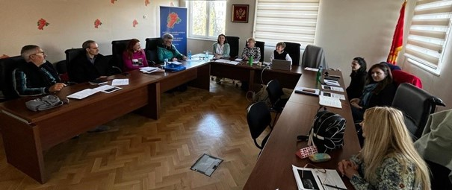
Project Outputs: Trainings
40 employees trained within Activities 3.1 and 3.2 on
requirements on EURES procedures
More

Slide 14
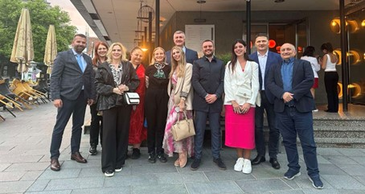
Project Outputs: Study Visits
In total 3 study visits were conducted within all three project components
10 participants were in June 2024 in Estonia on the visit focused on work with young NEETs (Activity 1.5)

Slide 15
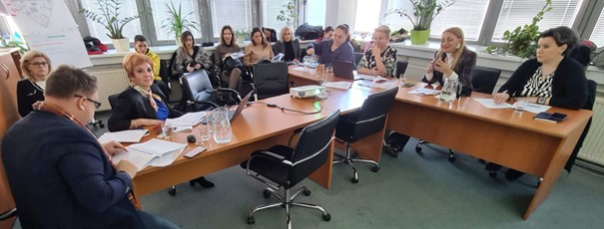
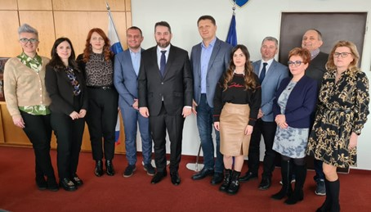
Project Outputs: Study Visits
10 participants were in November 2023 in Slovakia on the visit focused on work with EU funds (Activity 2.2)
8 participants were in March 2024 in Slovakia on the visit focused on key topics covered EURES (Activity 3.1)

Slide 16
Only 6 Months to Reach the Goal
The implementation of the project can be assessed as successful until now – the substantial portion of planned activities is finished; the rest is in good progress
The Twinning teams of MSs and BC partners successfully cooperate on a daily basis on all project matters
The work on many project activities is very interactive, the EAM staff has the opportunity to discuss the issues with the Twinning experts in the lively form during numerous workshops

Slide 17
Thank You
For Your Attention!

