Slide 1








Montenegro towards EU:
Labour Force Mobility
Panel 3:The EURES Network: a mobility network
Prepared by: Ms Nathalie Rivault,
Head of National coordination office in Federal employment agency (BA), Germany

Slide 2


Tell us more about you!
www.mentimeter.com
Code: 5194 8309
?

Slide 3
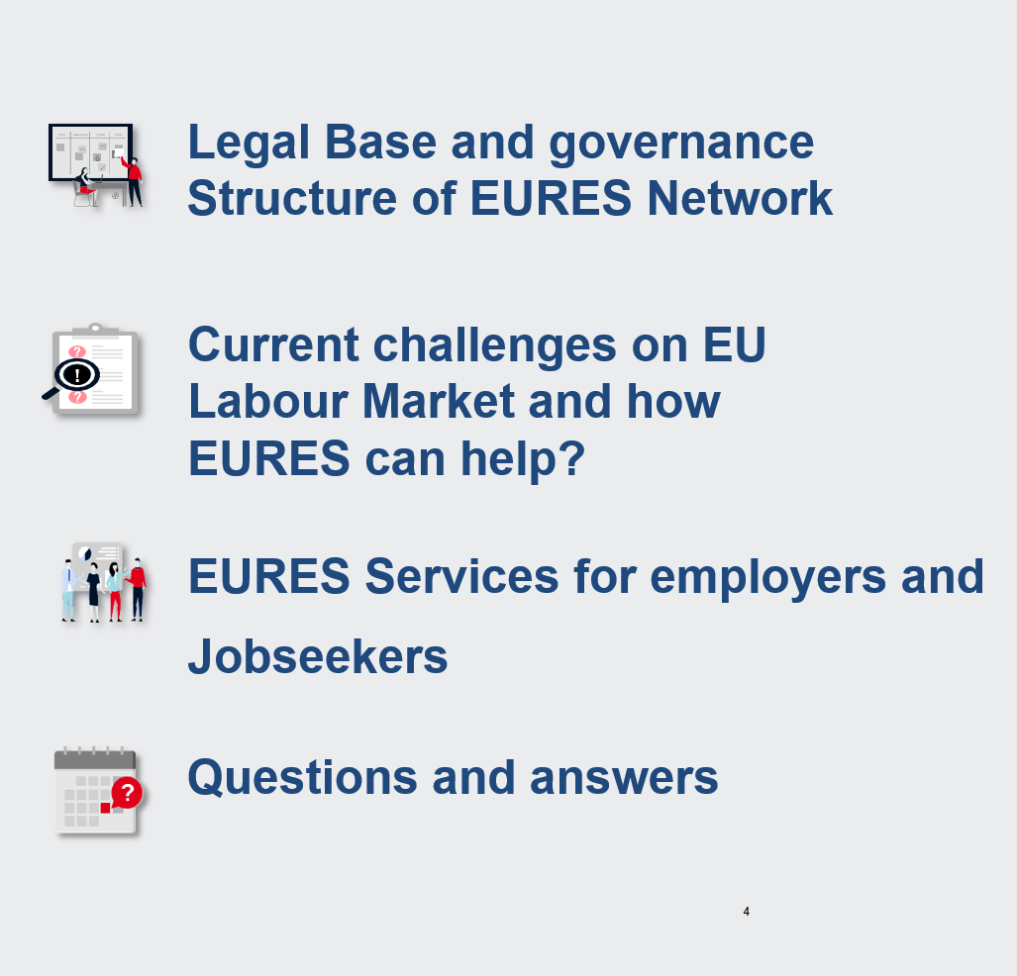


Slide 4

EURES Legal Base and governance

Slide 5
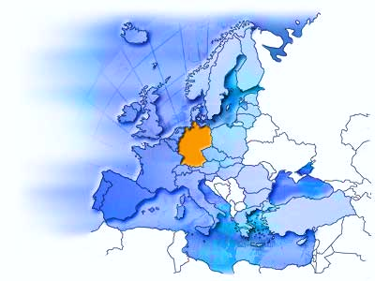
The European Employment Services network - EURES - is based on an EU Regulation
EURES
Goal
is a cooperation network of the labour market services and
EURES Members and
EURES partners of the Member States
and the EU Commission
is mobility on the European
Labour market on fair terms
Activity
Basis
EURES organisations provide services to all citizens who wish to take advantage of the free movement of workers in the EU (workers, employers).
The EURES Regulation 2016/589 of 13 April 2016 has the force of law.
It describes the structure of the EURES network as well as its tasks and obligations.

Slide 6
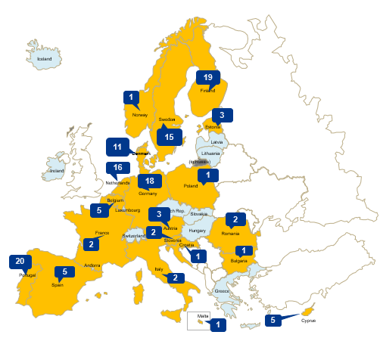

The EURES-Network: from a PES network to a mobility stakeholder network
Countries with authorised EURES members/
-partners
Around 240 facilities in the network
incl. regional PES
of which: 115 authorised facilities
EURES members (38)
EURES Partners (77)
  private employment agencies
  Social partner
  Other e.g. chambers, universities, counselling institutions
Number of authorised EURES members/partners (excluding PES)
EURES portal:
EURES in Your Country

Slide 7

10 good reasons to join the network
Make use of EURES brand and logo
Use EURES portal as common platform
Form national and EU partnerships
Know and attend EURES events
Affect European labour market policy
Win reliable partners throughout Europe
Know and use EU training programmes
Offer innovative services
Provide and use expert knowledge
Know and use EU funding programmes

Slide 8

Current challenges on the labour market and how
EURES helps to meet them

Slide 9
EU-wide trends on labour market accentuate current labour shortages
Digitalisation
Transformation/greening
Demography

Slide 10

EURES combines effectively the portal´s functionalities with human expertise
Self-information on working and living conditions
1.000.000 Job profiles
4.000.000 vacancies
Access to EURES counsellors
Links with EUROPASS
Information on freedom of movement and living and working conditions
Duties and rights
Referral advice to organisations that provide support in cases of conflict
Follow-up support and referrals
EU funding programmes
EURES portal
1.000
EURES Advisors

Slide 11

EURES services: for employers and jobseekers

Slide 12


Let the beneficiaries speak about EURES services themselves

Slide 13



You can trust: EURES has 30 years of experience
1994: Kick-off in Brussels with 400 advisers from 18 countries
1998: First EURES website is launched
2001: EURES CV data base is launched
2003: First EURES portal is taking up service
2006: European Job Days are launched
2012: First „TMS“ funding project is provided
2016: EURES Regulation (EU) 2016/589 enters into force
2018: Start of the authorisation procedure for members & partners
2019: Foundation of the European Labour Authority (ELA)

Slide 14

Thank You
For Your Attention!

