Slide 1
Montenegro towards EU: Labour Force Mobility
Panel 2: EU Labour Market Today and the Role of
Labour Mobility
Prepared by: Mr Lambert Kleinmann,
European Commission

Slide 2
3 mega trends lead to severe shortages on the EU labour market
Demographic Change
Ecological Transformation
Digital Transformation

Slide 5
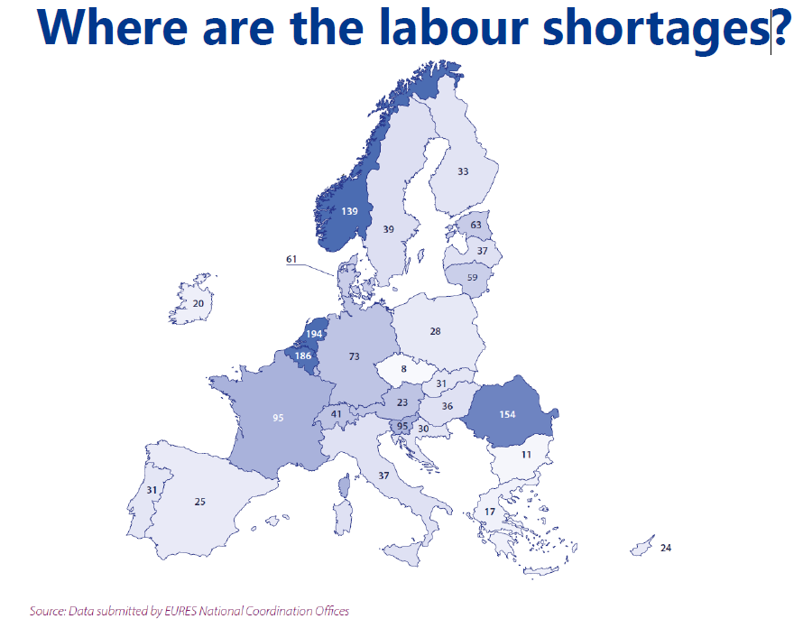

Slide 6
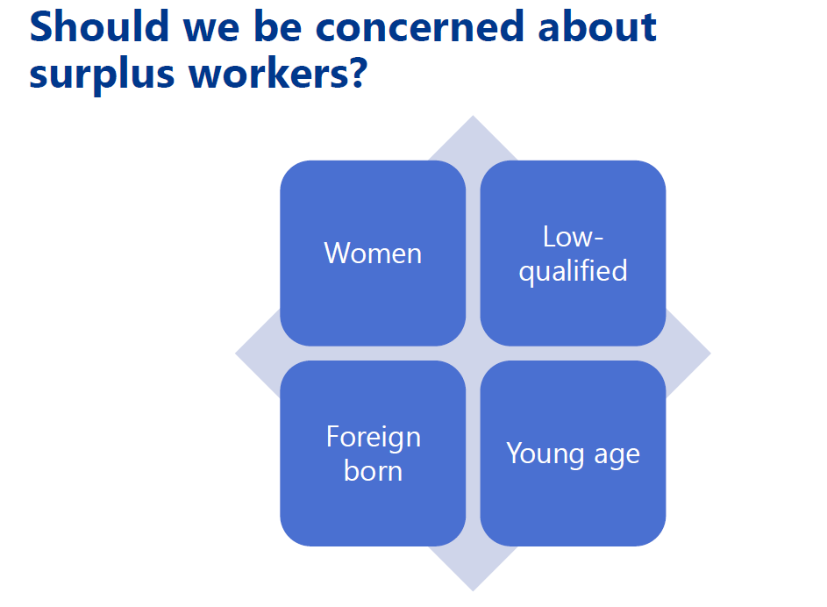

Slide 7
Labour and skills shortages can be countreacted through a joint action plan

Slide 11
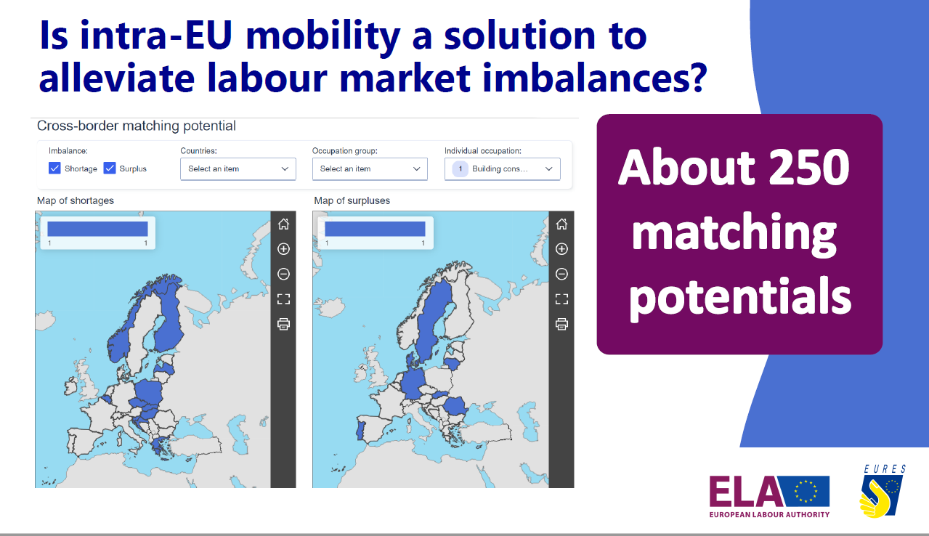

Slide 12
The mobility of employable citizens within Europe remains stable in 2022
In 2022, there were 9.9 million mobile citizens of working age (compared to 10.2 million in 2021)
83% of mobile EU citizens are active in the European labor market (in comparison to 70% from third countries)
The employment rate of EU citizens stands at 77%, which is higher than the employment rate of most citizens
The main countries of origin for mobile labour force continue to be Romania, Poland, and Italy
In 2022, there were more returnees than in previous years, with the majority returning to Romania.
32% of EU citizens are highly qualified, with a rising trend

Slide 13
Thank You
For Your Attention!

